Slide 1
Data Structures and Algorithms -3 (25CS2103E)
Title of the project
Team Members: K. Sankeerthana Thanmaye
Rollno:2520090193
Under the Esteemed Guidance of: Mrs. Ch. Anitha
Name of the DSA-3 faculty name with designation and department

Slide 2
Contents
Abstract
Introduction
Literature survey
Problem Statement and Objectives
Hardware and Software requirements
Results
Conclusion
Future Scope

Slide 3
Abstract
The Google Maps Route Visualizer is a graph-based route-finding system designed to identify the shortest and most efficient path between two locations. The road network is represented as a weighted graph, where locations are vertices and roads are weighted edges based on distance or travel cost. Dijkstra’s Algorithm is used to calculate the shortest path, while A* Search can be used as an optimized alternative for faster destination-directed search. The system uses an adjacency list and priority queue for efficient graph processing and reconstructs the final route using parent-node information. The project demonstrates the practical application of Data Structures and Algorithms (DSA) in real-world navigation and route optimization.

Slide 4
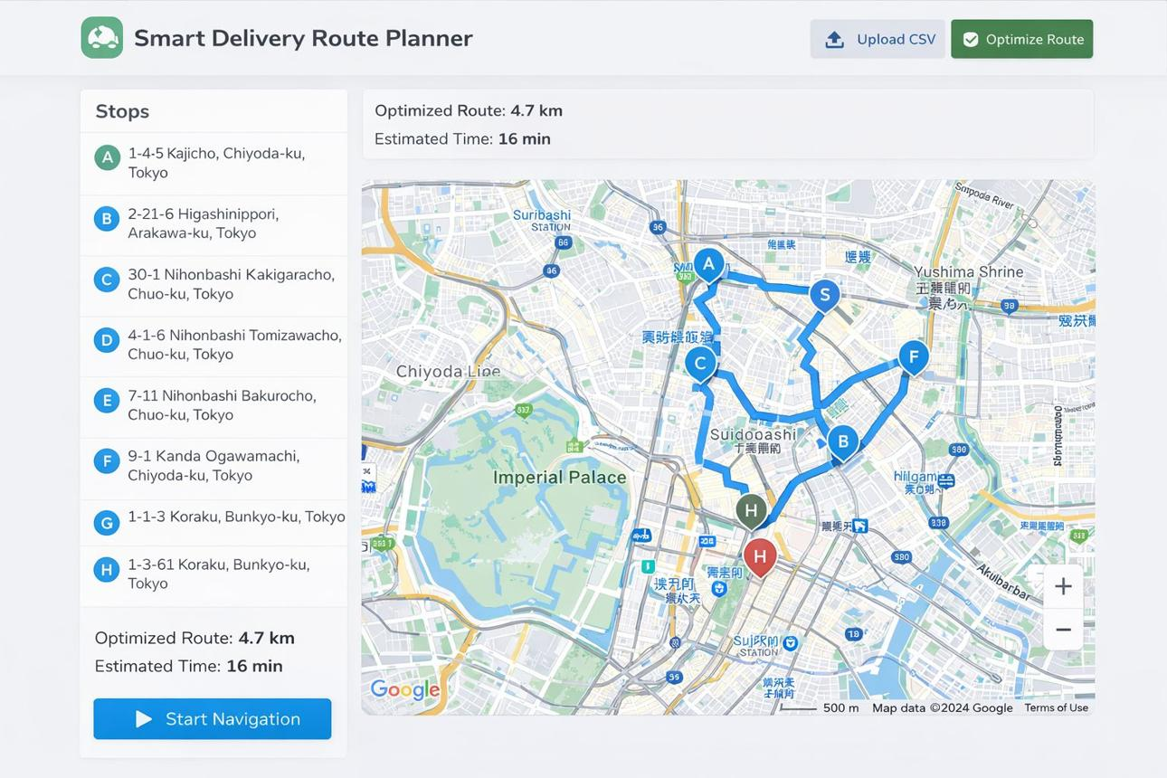
Introduction
Route planning is a shortest-path problem on a weighted graph.
Locations/intersections are represented as vertices (nodes).
Roads are represented as weighted edges using distance or travel costs
The system finds an efficient route from a chosen source to a destination.
Dijkstra’s algorithm is suitable when edge weights are non-negative. cite turn0search1 turn 0search3

Slide 5
Literature Survey
Study / Author | Focus | Key Finding | Relevance to Our Project
Dijkstra (1959) | Shortest-path algorithm | Introduced an efficient method for finding the shortest path in a graph with non-negative edge weights. | Forms the core algorithm of our route-finding system.
Hart, Nilsson & Raphael (1968) | A* Search | Proposed A* search using path cost and a heuristic to guide the search toward the destination. | Provides a faster alternative to Dijkstra for map-based navigation.
Zeng & Church (2009) | Shortest-path algorithms for road networks | Studied shortest-path computation specifically in transportation networks. | Supports the use of graph-based routing for road networks.
Bast et al. (2016) | Route planning in transportation networks | Reviewed advanced techniques for extremely fast route planning on large road networks. | Shows how basic shortest-path methods can be extended for large-scale navigation systems.

Slide 6
Problem Statement and Objectives
The Challenge
The Goal
Efficiently finding the shortest path between a source and destination when there are multiple possible routes, different road distances, and a large number of locations. The system must process this graph quickly and return the optimal route
To efficiently calculate and visualize the shortest route between two locations using graph algorithms
Input
Output
Source Location – The starting point.
Destination Location – Where the user wants to go.
Road Network – The locations (nodes) and roads connecting them (edges).
Distance/Cost of Roads – The weight assigned to each road.
The output of the Google Maps Route Visualizer is the shortest/optimal route between the selected source and destination, along with its total distance or cost.

Slide 7
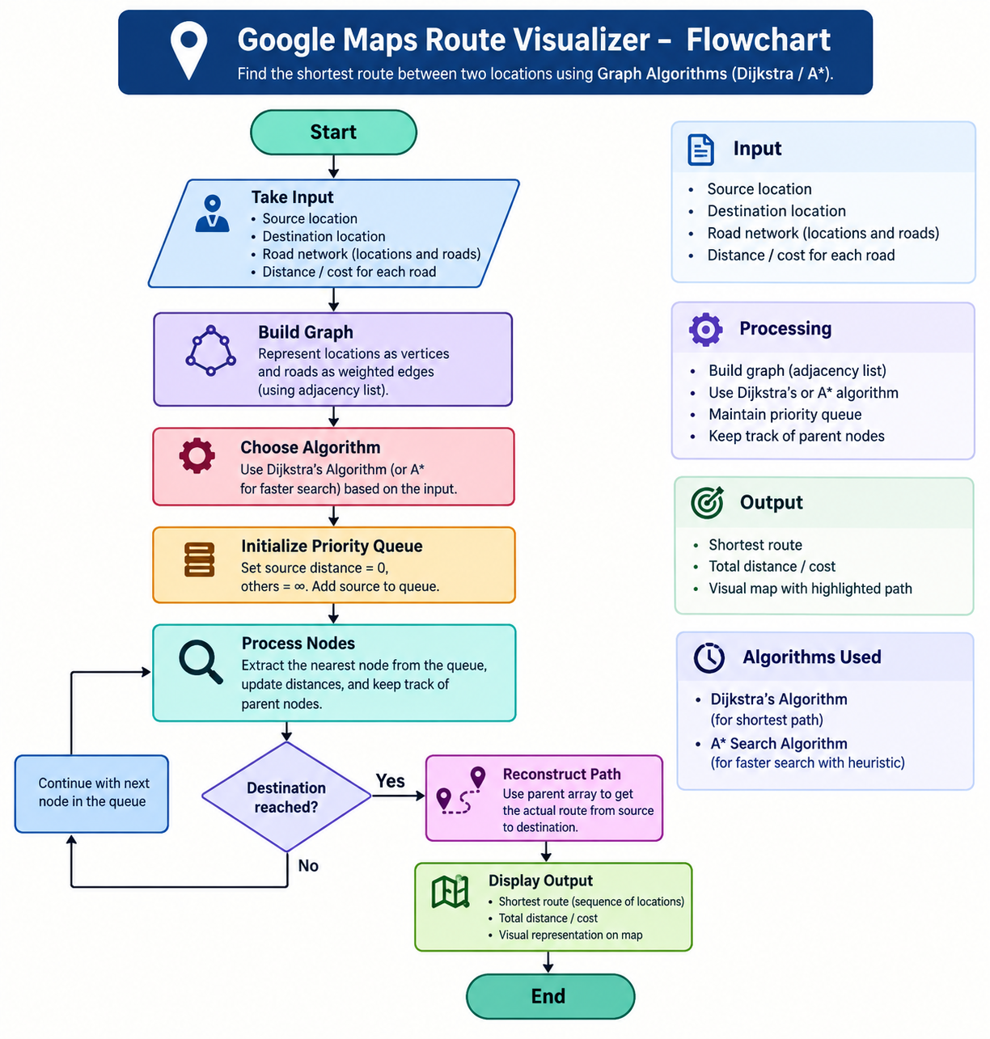
Flow Chart

Slide 8
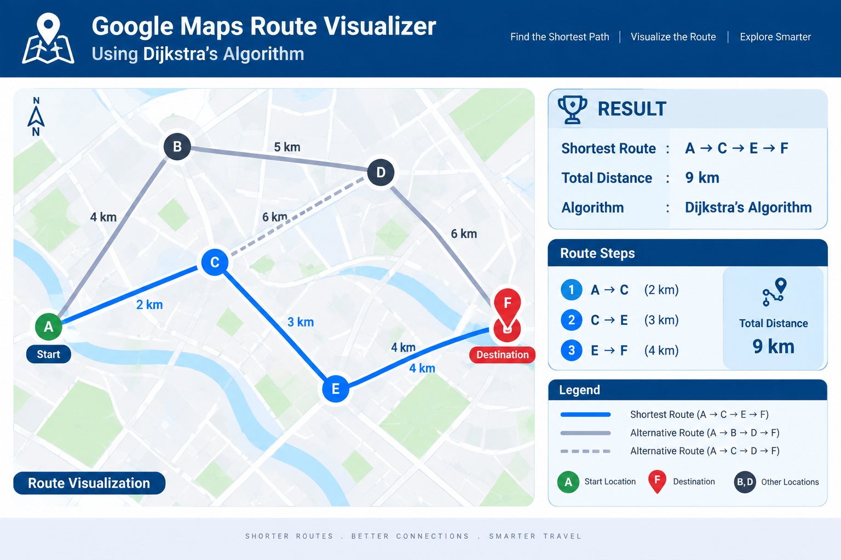
Results
The Google Maps Route Visualizer successfully finds the shortest route between a given source and destination using a weighted graph and Dijkstra’s algorithm.
Example Result
Input:
Source: A
Destination: F
Available routes:
A → B → D → F = 4 + 5 + 6 = 15
A → C → D → F = 2 + 8 + 6 = 16
A → C → E → F = 2 + 3 + 4 = 9
Final Output
Source : A
Destination : F
Shortest Route : A → C → E → F
Total Distance : 9 km
Algorithm Used : Dijkstra's Algorithm

Slide 9
Hardware and Software requirements
Software Requirements
Software | Purpose
Windows / Linux / macOS | Operating system
Java JDK 17+ | Development and execution
VS Code / IntelliJ IDEA / Eclipse | Java programming
Java Collections Framework | Graph, Array List & Priority Queue
Web Browser | Viewing maps/visualization
Google Maps / Map API (optional) | Real-world map integration
Git & GitHub (optional) | Version control and project hosting
Hardware Requirements
Component | Minimum Requirement
Processor | Intel Core i3 / AMD Ryzen 3 or above
RAM | 4 GB minimum, 8 GB recommended
Storage | 500 MB free space
Display | 1366 × 768 or higher
Keyboard & Mouse | Standard
Internet | Required if using online map services

Slide 10
Conclusion
The Google Maps Route Visualizer successfully demonstrates the practical application of Data Structures and Algorithms in real-world route planning. By representing locations and roads as a weighted graph and applying Dijkstra’s Algorithm, the system can identify the shortest and most efficient route between two locations. The use of adjacency lists, priority queues, and path reconstruction makes the solution efficient and easy to understand. The project also provides a strong foundation for future enhancements such as A* search, GPS integration, real-time traffic updates, and AI-based route recommendations.
Overall, the project shows how graph algorithms can be effectively used to solve real-world navigation and optimization problems.

Slide 11

Future Scope
🚀 Future Scope
The project can be further developed into a real-time and intelligent navigation system by integrating live traffic data and GPS for accurate route updates. A* can be implemented for faster pathfinding, while interactive maps can visually display the selected route. Future versions can also provide multiple route options, support different transportation modes, and use AI to predict traffic and recommend better routes.
Overall, the system can evolve from a basic DSA-based shortest-path project into a smart, real-time navigation application.
Real-time traffic → A* optimization → GPS integration → Multiple routes → Dynamic road conditions → AI-based prediction → Voice navigation → Multi-modal transportation → Large-scale graph optimization → Personalized navigation

Slide 12
Thank you

